Slide 1
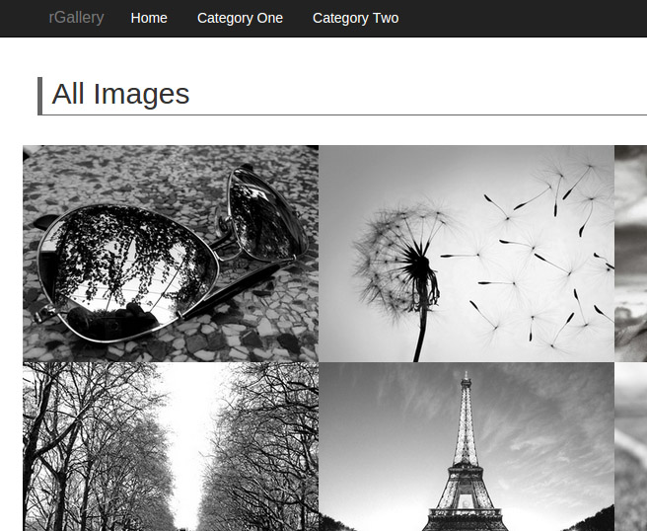
Projects Using Ruby on Rails
Project 3 Intro – rGallery Image Gallery

Slide 2
Project Description & Features
Implement a photo gallery with categories
Photos will have a title and description
Photos will open up in a Lightbox when clicked
Carrierwave Gem will be used for uploading and image processing
Image & category CRUD in frontend

Slide 3
Project Sections
Section 1: Project Introduction
Section 2: rGallery UI
Section 3: Dependencies & Resources
Section 4: Layouts & Views
Section 5: Carrierwave Image Uploader
Section 6: Edit & Delete Functions

Slide 4
What You’ll Learn
SQL3Lite database integration & console
MVC framework fundamentals
CRUD operations in Rails
Bootstrap-Sass Gems
Carrierwave - Image upload gem
jQuery Lightbox
jQuery hover effect

Slide 5
Let’s Do It!
Let’s go code!

